Slide 1
LET HOT ITEMS !

Slide 2
POP UP QUIZ!
1. Learning English for some Filipinos is difficult because ____________. A. It is a complex Language B. It is a strange Language C. It is a universal language D. It is either a second or third Language

Slide 3
POP UP QUIZ!
1. Learning English for some Filipinos is difficult because ____________. A. It is a complex Language B. It is a strange Language C. It is a universal language D. It is either a second or third Language

Slide 4
POP UP QUIZ!
2. ESP is mainly concerned about the following topics except for ________. A. Grammar and Lexis B. Register C. Discourse and Genre. D. Prose and Prosody.

Slide 5
POP UP QUIZ!
2. ESP is mainly concerned about the following topics except for ________. A. Grammar and Lexis B. Register C. Discourse and Genre. D. Prose and Prosody.

Slide 6
3. Which of the following is not a definition of the word Contextualization ? A. teaching and learning directly on concrete applications in a specific context that is of interest to the student.
B. statement or event is to place it within its larger setting in which it acquires its true and complete meaning.
C. the process of adapting and relating the content of the curriculum and the process of teaching and learning to local condition, environment, and resources. D. the process of presenting lesson in meaningful and relevant context based on previous experiences and real-life situations.

Slide 7
3. Which of the following is not a definition of the word Contextualization ? A. teaching and learning directly on concrete applications in a specific context that is of interest to the student.
B. statement or event is to place it within its larger setting in which it acquires its true and complete meaning.
C. the process of adapting and relating the content of the curriculum and the process of teaching and learning to local condition, environment, and resources. D. the process of presenting lesson in meaningful and relevant context based on previous experiences and real-life situations.

Slide 8
LOCALIZATION VS CONTEXTUALIZATION?
PQF VS NCBTS ?

Slide 9


Slide 10
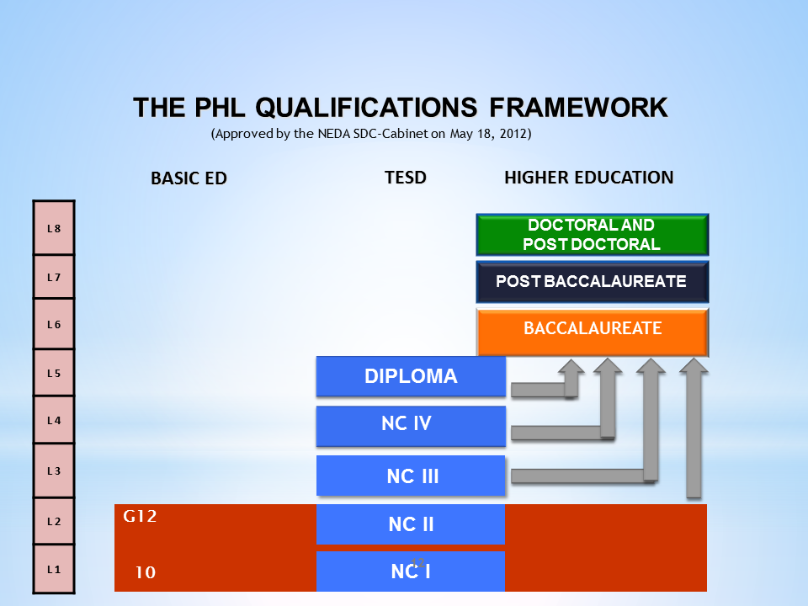

Slide 11
PQF VS NCBTS ?
PQF - Content and performance standard for students.
NCBTS - defines the different dimensions of effective teaching

Slide 12
SUBJECT VERB AGREEMENT INVERTED SENTENCES
DEMONSTRATIVE PRONOUNS
PHONOLOGICAL AWARENESS

Slide 13
Identify the word formation process for the following words.
Read- Reading Editor – Edit Emote + Icon = Emoticon Kindergarten – Kinder Sun+glasses = Sunglasses 'He words me.' - drink- drinkable –
Doppelgänger- Pook-Sapot -

Slide 14
Identify the word formation process for the following words.
Read- Reading > AFFIXATION
Editor – Edit > BACK FORMATION
Emote + Icon = Emoticon > BLENDING
Kindergarten – Kinder > CLIPPING

Slide 15
Sun+glasses = Sunglasses COMPOUNDING
'He words me.' - CONVERSION
drink- drinkable - DERIVATION
Doppelgänger- LOAN WORDS
Pook-Sapot - NEOLOGISM

Slide 16
Some Common Types of Word Formation
Affixation
Back Formation
Blending
Clipping (Shortening, Truncation)
Compounding
Conversion
Denominal Adjective, Denominal Noun, and Denominal Verb
Derivation
Derivational Morpheme and Inflectional Morpheme
First-Sister Principle
Loan Translation (Calque)
Loanword
Neologism
https://www.thoughtco.com/word-formation-1692501

Slide 17
POP UP QUIZ!
4. What is the term for a speaker who is capable of operating his/her linguistics and sociolinguistic skills ? A. Intercultural B. Linguistic C. Discourse Speaker D. Strategic Speaker

Slide 18
POP UP QUIZ!
4. What is the term for a speaker who is capable of operating his/her linguistics and sociolinguistic skills ? A. Intercultural B. Linguistic C. Discourse Speaker D. Strategic Speaker

Slide 19
The term ‘communicative competence’ was first introduced by Hymes in (1972) as a sociolinguistic concept in reaction to the concept of ‘linguistic competence’ which was proposed by Chomsky in 1965.

Slide 20
Hymes (1972) ‘communicative competence’ refers to the level of language learning that enables language users to convey their messages to others and to understand others’ messages within specific contexts.

Slide 21
‘Communicative competence’ were later developed by Canale and Swain in 1980 who introduced a theoretical model of ‘communicative competence’.
“the relationship and interaction between grammatical competence, or knowledge of the rules of grammar, and sociolinguistic competence, or knowledge of rules of language use” (Canale & Swain, 1980: 6).

Slide 22
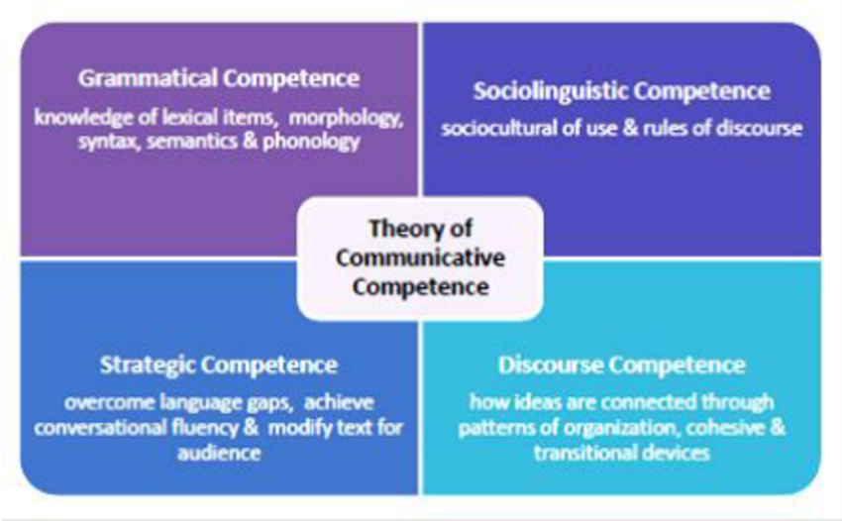

Slide 23
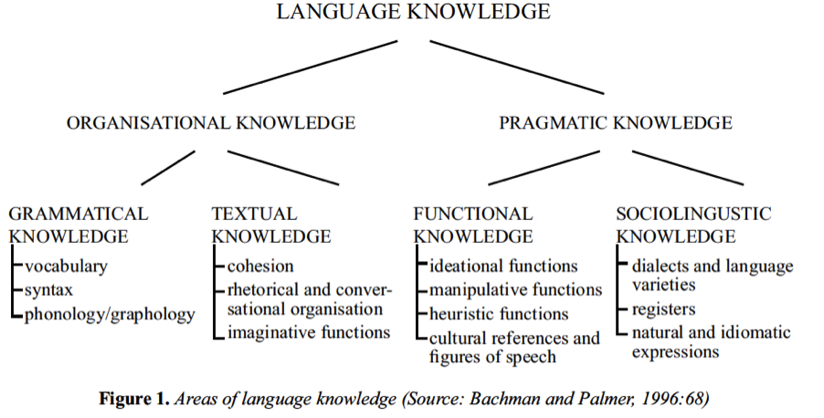

Slide 24
Interlanguage (IL) was introduced by the American linguist Larry Selinker to refer to the linguistic system evidenced when an adult secondlanguage learner attempts to express meanings in the language being learned.

Slide 25
The interlanguage is viewed as a separate linguistic system, clearly different from both the learner’s ‘native language’ (NL) and the ‘target language’ (TL) being learned, but linked to both NL and TL by interlingual identifications in the perception of the learner.

Slide 26
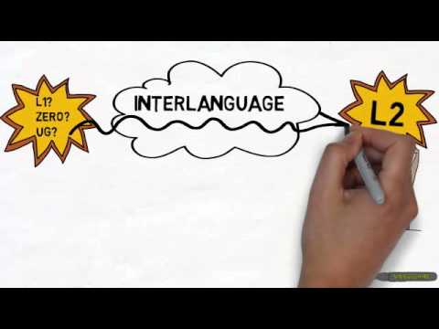

Slide 27
5. Which of the following term pertains to the study of ways in which non-native speaker acquire, comprehend, and use linguistic patterns or speech acts in a second language ? A. Speech Act Theory B. Second Language Acquisition C. Inter-language Pragmatics
D. Monitor

Slide 28
5. Which of the following term pertains to the study of ways in which non-native speaker acquire, comprehend, and use linguistic patterns or speech acts in a second language ? A. Speech Act Theory B. Second Language Acquisition C. Inter-language Pragmatics
D. Monitor

Slide 29
6. In Language Learning, which of the following is not part of motivational teaching practice ?
A. Creating basic motivational conditions
B. Generating initial student motivation
C. Maintaining and promoting motivation
D. Providing Feedback

Slide 30
6. In Language Learning, which of the following is not part of motivational teaching practice ?
A. Creating basic motivational conditions
B. Generating initial student motivation
C. Maintaining and promoting motivation
D. Providing Feedback

Slide 31
INTRINSIC VS EXTRINSIC MOTIVATION
INTEGRATIVE VS INSTRUMENTAL MOTIVATION

Slide 32
Learners with an instrumental motivation want to learn a language because of a practical reason such as getting a salary bonus or getting into college. Many college language learners have a clear instrumental motivation for language learning.
Integratively motivated learners want to learn the language so that they can better understand and get to know the people who speak that language.

Slide 33
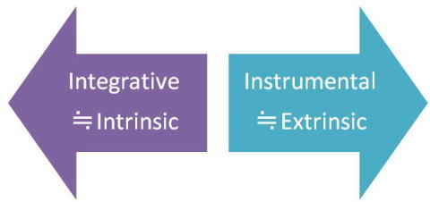

Slide 34
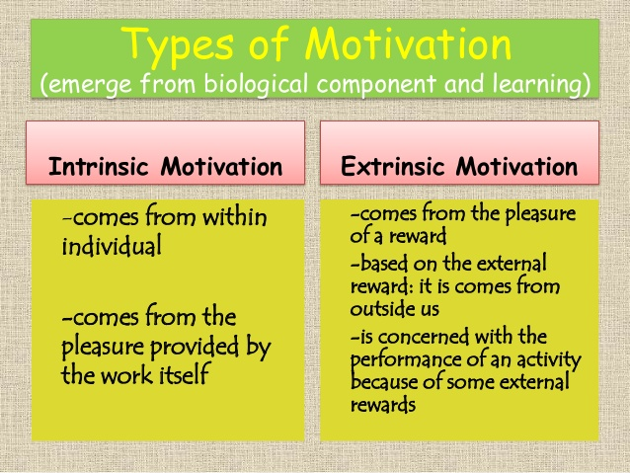

Slide 35
7. Teacher Anna emphasized the need for her students to be motivated before starting a new lesson, As a result, she shared a story about learning for empowerment and better self-image. What type of motivation did she use in her class ? A. Genuine Motivation B. Intrinsic Motivation C. Extrinsic Motivation D. Life-long Learning

Slide 36
7. Teacher Anna emphasized the need for her students to be motivated before starting a new lesson. As a result, she shared a story about learning for empowerment and better self-image. What type of motivation did she use in her class ? A. Genuine Motivation B. Intrinsic Motivation C. Extrinsic Motivation D. Life-long Learning

Slide 37
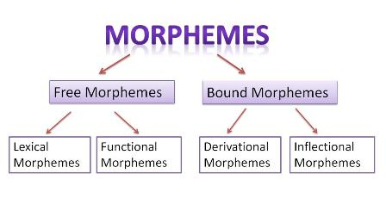

Slide 38
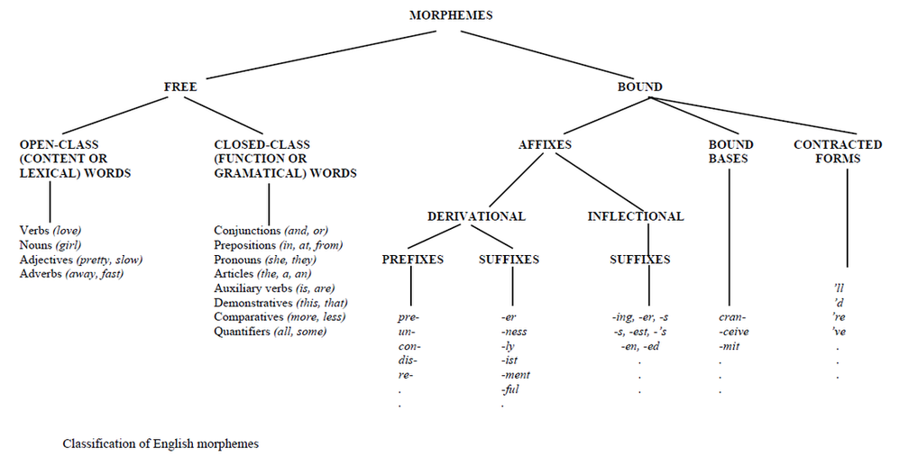

Slide 39
Vocabulary
Profligate
Superluous
Stiffen

Slide 40
Professor Patte author of the standard history of American Short story has outlined the require sites of a modern short story which are as follows:
1. the story must be short, one that can be read at a single sitting.
2. there must be compression; backgrounds must be sketched, not elaborated
3. there must be unity, a single line of action or single situation

Slide 41
4. the story must have immediateness; from the very start reader must be given the nature of the situation and characters.
5. there must be a continuous momentum, no let down until the end.
6. the characterization must be such that the characters will reveal themselves.
7. the story must have verisimilitude, impressing the reader as natural and true.

Slide 42
8. the story must be style. The writer must have a distinction in phrasing
9. there must be culmination, the story having an object toward which it constantly moves.
10. the story must have “soul:. It must shed light in some way upon the human tragedy or human comedy.”

Slide 43
Rhetorical devices
Definition of Polyptoton
Polyptoton is a stylistic device that is a rhetorical repetition of the same root word, however, each time the word is repeated in a different way such as the words Iuppiter, lovi, lovis, lovem are derived from a root word “love”.
The Greeks are strong, and skillful to their strength, fierce to their skill, and to their fierceness valiant….”

Slide 44
“Hourly joys be still upon you! Juno sings her blessings on you. . . . Scarcity and want shall shun you, Ceres’ blessing so is on you.”
(The Tempest by William Shakespeare)
Epiphora Definition
Epiphora, also known as epistrophe, is a stylistic device in which a word or a phrase is repeated at the end of successive clauses. Examples of epiphora are not only found in literary pieces. Debates and persuasive writings are also rich with epiphora examples.
“Hourly joys be still upon you! Juno sings her blessings on you. . . . Scarcity and want shall shun you, Ceres’ blessing so is on you.”
(The Tempest by William Shakespeare)

Slide 45
Gradatio is a rhetorical term for a sentence construction in which the last word(s) of one clause becomes the first of the next, through three or more clauses (an extended form of anadiplosis). Gradatio has been described as the marching or climbing figure of speech. Also known as incrementum and the marching figure (Puttenham).
"They call for you: The general who became a slave; the slave who became a gladiator; the gladiator who defied an Emperor. Striking story." (Joaquin Phoenix in the film Gladiator, 2000)

Slide 46
Cliffhanger
A cliffhanger is a type of narrative or a plot device in which the end is curiously abrupt so that the main characters are left in a difficult situation without offering any resolution of conflicts.
Cliffhanger has its roots in ancient oriental literature. One example is in the collection of stories known as “One Thousand and One Nights”. The king “Shehreyar” orders her queen “Scheherzade” to be hanged. She devises a plan to tell a story to the king every night and ending that story with a cliffhanger. The king postponed the order of execution every morning to hear the rest of the story.

Slide 47
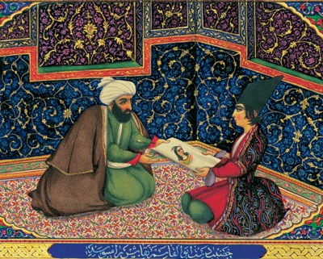
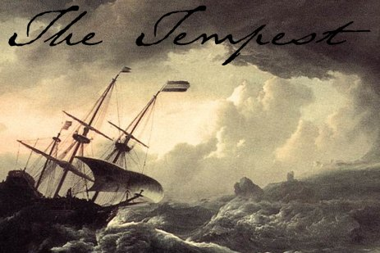

Slide 48
Shakespeare could not afford his audience to be bored and for this reason he uses a cliffhanger in Act 1 Scene 1 of his play “The Tempest”. The scene of a storm and shipwreck is depicted in a most vivid manner but the audience is unsure if anybody on the ship survived. The device is employed with the purpose that the audience will return to see the next act. Finally, the fate of the crew on board is revealed in Act 2 Scene 1 and the focus of the audience is ensured by that time.

Slide 49

Anti-hero is a literary device used by writers for a prominent character in a play or book that has characteristics opposite to that of a conventional hero. The protagonist is generally admired for his bravery, strength, charm, ingenuity etc. while an anti-hero is typically clumsy, unsolicited, and unskilled and has both good and bad qualities.

Slide 50
Allegory Definition
Allegory is a figure of speech in which abstract ideas and principles are described in terms of characters, figures and events.
It can be employed in prose and poetry to tell a story with a purpose of teaching an idea and a principle or explaining an idea or a principle. The objective of its use is to preach some kind of a moral lesson.

Slide 51
The Tortoise and the Hare from Aesop’s Fables: From this story, we learn that the strong and steady win the race.
The story of Icarus: Icarus fashions wings for himself out of wax, but when he flies too close to the sun his wings melt. This story is a message about the dangers of reaching beyond out powers.
Yertle the Turtle by Dr. Seuss: This story about a turtle who yearns for too much power is actually an allegory about Adolf Hitler and the evils of totalitarianism.
The Hunger Games: This trilogy of Young Adult books (and now blockbuster movies) is an allegory for our obsession with reality television and how it numbs us to reality.
http://www.literarydevices.com/allegory/

Slide 52
8. What figure of Speech is : “O wild, west wind!” A. Apostrophe B. Hyperbole C. Irony D. Metaphor

Slide 53
8. What figure of Speech is : “O wild, west wind!” A. Apostrophe B. Hyperbole C. Irony D. Metaphor

Slide 54
Examples of Figures of Speech and Rhetorical DevicesStanza 1
Alliteration: wild West Wind (line 1). Apostrophe, Personification: Throughout the poem, the poet addresses the west wind as if it were a person. Metaphor: Comparison of the west wind to breath of Autumn's being (line 1). Metaphor: Comparison of autumn to a living, breathing creature (line 1). Anastrophe: leaves dead (line 2). Anastrophe is inversion of the normal word order, as in a man forgotten (instead of a forgotten man) or as in the opening lines of Samuel Taylor Coleridge's "Kubla Kahn": In Xanada did Kubla Kahn / A stately pleasure dome decree (instead of In Xanadu, Kubla Kahn decreed a stately pleasure dome). Here is another example, made up to demonstrate the inverted word order of anastrophe:

Slide 55
The Trojan war can be seen today as ____ A. Women’s empowerment B. The War over lands and Boundaries C. Men’s Exhibition of grief D. The reign of Political Dynasty.

Slide 56
The Trojan war can be seen today as ____ A. Women’s empowerment B. The War over lands and Boundaries C. Men’s Exhibition of grief D. The reign of Political Dynasty.

Slide 57
The presumptive kidnapping of Helen can be seen merely an excuse to launch a pre-ordained war for control of land, trade, profit, and access to the Black Sea.

Slide 58
The myths of the Greek reflect _________________ A. A view of the universe that acknowledge the mystery and beauty of humanity. B. That humans are the center of the universe C. that humans and gods live alike D. a less strange and frightening magic than the myths of other ancient civilization.

Slide 59
The myths of the Greek reflect _________________ A. A view of the universe that acknowledge the mystery and beauty of humanity. B. That humans are the center of the universe C. that humans and gods live alike D. a less strange and frightening magic than the myths of other ancient civilization.

Slide 60
Hamilton argues, the myths of the Greeks reflect a view of the universe that acknowledges the mystery and beauty of humanity.

